Slide 1
TOOL FOR FINDING SIMILAR PLACES IN CENSUS DATA
Riin Aljas

Slide 2
GOAL?
Tool which helps us to choose certain parameters from census data helping to group and factor certain locations.

Slide 3
WHY DO WE NEED IT? CASE STUDY OF OPIOIDS AND MARTINSVILLE
2019 summer opioid data from 2006-2012
Martinsville has the nation’s 2nd highest pill count per person
Did people really buy a lot of opioids or is there something else going on?

Slide 4
POSSIBLE IMPACT
Makes reporting quicker
Helps to notice anomalies quicker and avoid wasting time on a ghost story
Points us to places which might have similar issues, hence widen the scope of any story

Slide 5
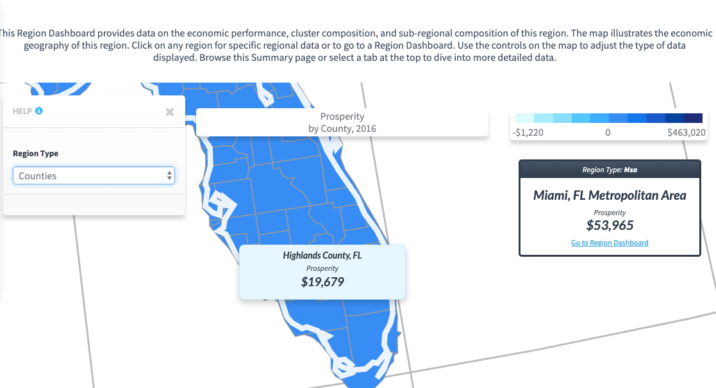
ARE WE REINVENTING THE WHEEL?
CLUSTERMAPPING.US

Slide 6
HOW?
The prototype will use US census data (2017 American Community Survey 2017 5 year predictions) with few prechosen parameters, but ideally the model should be built in a way that it could be customized for all parameters in census data and for other datasets (e.g if I want to do the same with Argentinian census data or go more in detail by using Maryland school districts instead of census data)
Programming resource: R (packages: tidyverse, tidycensus, philentropy, shiny)

Slide 7
METHODOLOGY
get data through census api
join and rename tables
calculate Euclidean distance
presave for faster loading
build and interactive web application based on user selection

Slide 8
Did we succeed?
APP LINK for version 1.0
GITHUB REPO

Slide 9
LIMITATIONS AND FUTURE WORK
AS IS
algorithm can be customized for any data, but basic cleaning algorithm needs to be added
Don’t know the optimal number of parameters suited for the code
Code needs to be developed further so that parameters for eucledian distance would be chosen by function

Slide 10
TO BE:
FIXED:
Data based on user input/upload
Interface fix for selecting variables
Tests to understand the optimal data size and parameters
Make sorting easier
ADDED:
Choropleth map to grasp places of interest at once (option for known regions only, R code suitable)

Slide 11
DELIVERABLES SET AND MET?
IN SEPTEMBER
Script which will create functions for easy factorization of state/county level data
If there’s time and skillset, work on very basic interface
IN DECEMBER
Goals met when it comes to basic functionality, goal to develop the app in Python didn’t deliver, but will try in future

